Slide 1
DBMS Powered Secure Attendance System

Slide 2

DBMS Powered Secure Attendance System.
In today's digital age, managing attendance efficiently while ensuring data security and user privacy is paramount. Our project addresses these challenges by integrating robust user authentication protocols with a relational database management system (DBMS), providing a secure and user-friendly solution for attendance management. Throughout this presentation, we will delve
into various aspects of our system,
features, technologies used,
highlighting its
advantages, and future advancements.

Slide 3
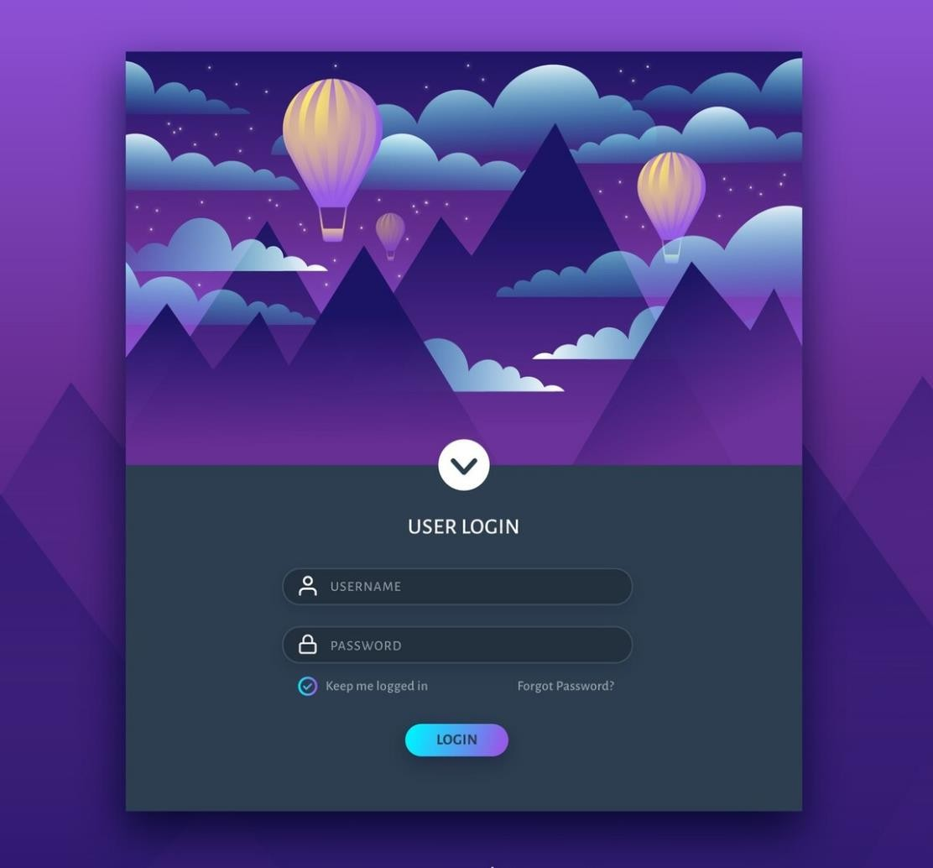
User Interface and Easiness
One of the key highlights of our Secure Attendance System is its intuitive user interface (UI) and ease of use. Built with modern front-end technologies such as HTML, CSS, and Bootstrap, our UI offers a responsive and visually appealing experience across different devices and screen sizes. Clear presentation of attendance details and intuitive controls streamline the attendance management
process, making | it easy | for | users to
navigate and | operate | the | system
efficiently.

Slide 4

File Components
Html, Css, js : For designing of User interface and interaction.
index.php: User dashboard with attendance management functionality.
login.php: Login form for user authentication.
registration.php: Registration form for new user account creation.
update_attendance.php: PHP script to update
attendance records in the database.
User_details.sql : This is the database that holds 4 table for all the student and teacher details along with data for password reset features and attendance recorded in different tables.

Slide 5
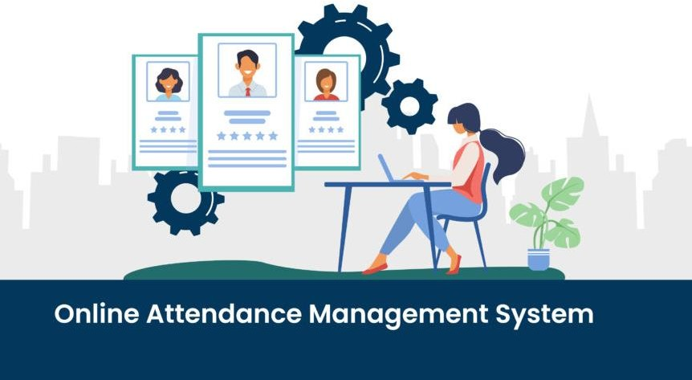
Features
Our Secure Attendance System offers a range of features to meet the diverse needs of users, including:
User Authentication
Dashboard for Attendance Management
Login and Registration Forms
Update Attendance Functionality
Forgot Password Reset
Secure Password Storage with Hashing

Slide 6






Languages and Technologies Used
The Secure Attendance System leverages a variety of languages and technologies, including:
PHP for server-side scripting and database interaction
MySQL for relational database management
HTML, CSS, Bootstrap for front-end development
JavaScript for client-side scripting
AJAX for asynchronous requests
Sessions for user authentication and session management

Slide 7
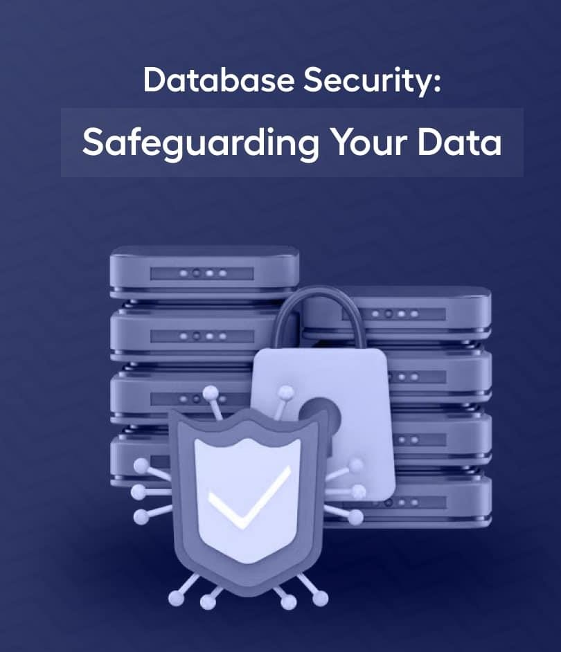
Advantages
There are several advantages to using our Secure Attendance System, including:
Enhanced Security: Robust user authentication and password hashing ensure data security and prevent unauthorized access.
Efficiency: Intuitive UI and features streamline attendance management, saving time and effort for users.
Scalability: The system is scalable to accommodate varying any numbers of users and attendance records.
Data Integrity: Reliable storage and querying of attendance records in a DBMS ensure data integrity and consistency.
User Privacy: Strict access controls and encryption mechanisms protect user privacy and sensitive information.

Slide 8
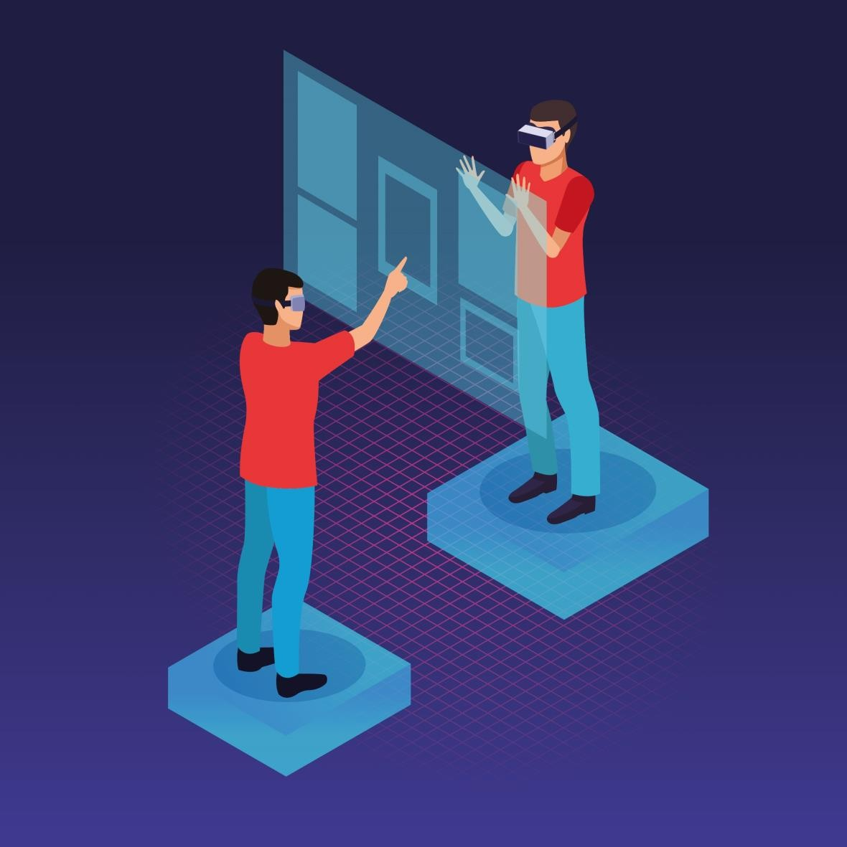
How to Use
To utilize our Secure Attendance System, follow these simple steps:
Clone the project repository to your local machine using Git.
Set up a local web server environment with PHP
and MySQL installed.
Import the provided SQL database file into your MySQL database.
Configure database credentials in the appropriate files.
Start the local server and access the system
through your web browser.
Log in with valid credentials to access the user dashboard and manage attendance effectively.
- Take demo at https://virusscan.rf.gd

Slide 9

Tap thank you ! below to visit deployed project.
GUEST LOGIN : {email : guest@gmail.com} , {password – GUEST@12}
Project live at : https://virusscan.rf.gd

